Slide 1
Component Based Architecture in Ruby
Bagus
(pronounced BAY-jus)
Director of Engineering @ Placewise Media
http://www.placewisemedia.com
bagus@placewise.com
bagus@megabar.net
http://megabar.net
https://github.com/megabar/megabar
https://megabar.slack.com

Slide 2
For today
Introduce Component Based Ruby Architecture
Dive into Engines
Introduce MegaBar

Slide 3
COMPONENTS
Components are Ruby on Rails engines or Ruby gems used as a building block of a Rails application.
Think about the different parts of your application independently as much as possible.
Modules - an easy way to organize models, views and controllers.
Example Malls vs. Stores vs. Articles
Gems - Code that doesn’t need your app to do its job.
custom validations, non-active-record models, etc.
Engines - Add Rails functionality to Gems
See Also: Service Objects, SOA, Loose Coupling, etc

Slide 4
COMPONENTS
One RePO or MAny?
For applications where reuse of code in other projects isn’t foreseen, it can make sense to create a /components directory in your repo to house your engines and gems.
You’ll then write your specs within those engines and gems and ultimately some shell scripts to run all tests in one step.
Otherwise separate repos for each engine or gem.
Your main app’s Gemfile can include them within the same repo, outside the repo or from RubyGems or wherever.

Slide 5
COMPONENTS
Profit
It's easier to understand and manage dependencies. For example, if you have some Gemfile dependency in a monolithic application, it is very unclear as to which portions of code are creating the dependency. When the code that creates the dependency is in a well contained gem or engine, it is obvious where this dependency comes.
It's easier to isolate a bug. If a test breaks in an engine, you know the problem is either in the engine or one of it's dependencies. If you had a monolithic application, and the test broke, the problem could be anywhere.
Reduce Unit-test run-time. This is crucial for reducing the feedback look during continuous integration and during local development. When your projects are smaller and your making changes, it is a lot quicker to run just the unit-tests in the area you are making changes, then to run every test in a monolithic application.

Slide 6
COMPONENTS
Profit
Easier to manage dependencies.
Big apps lose track of which parts require the dependencies.
Easier to isolate Bugs
If a test fails in an engine, you know the problem is with the engine or with one of it’s dependencies.
Easier to test individual portions of your project.
Just run the specs in your area.
Plug and Play Functionality for your clients!

Slide 7
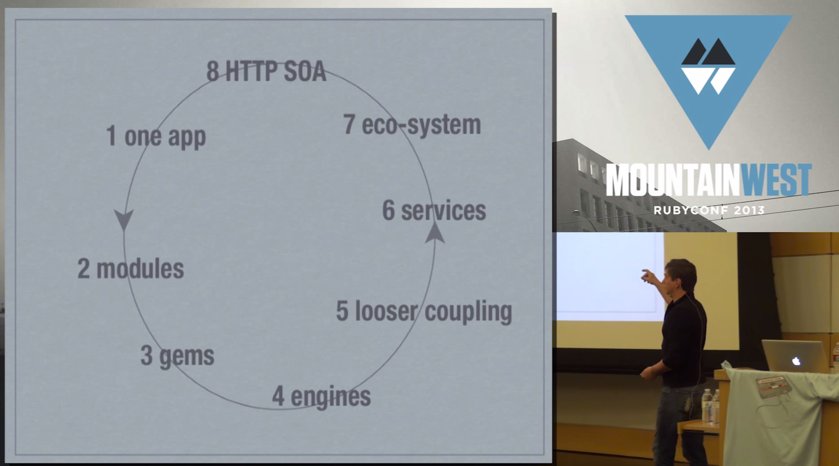
COMPONENTS
Component is the name given to a Ruby on Rails engine or Ruby gem when used as building block of a Rails application.
Stephan Hagemann

Slide 8
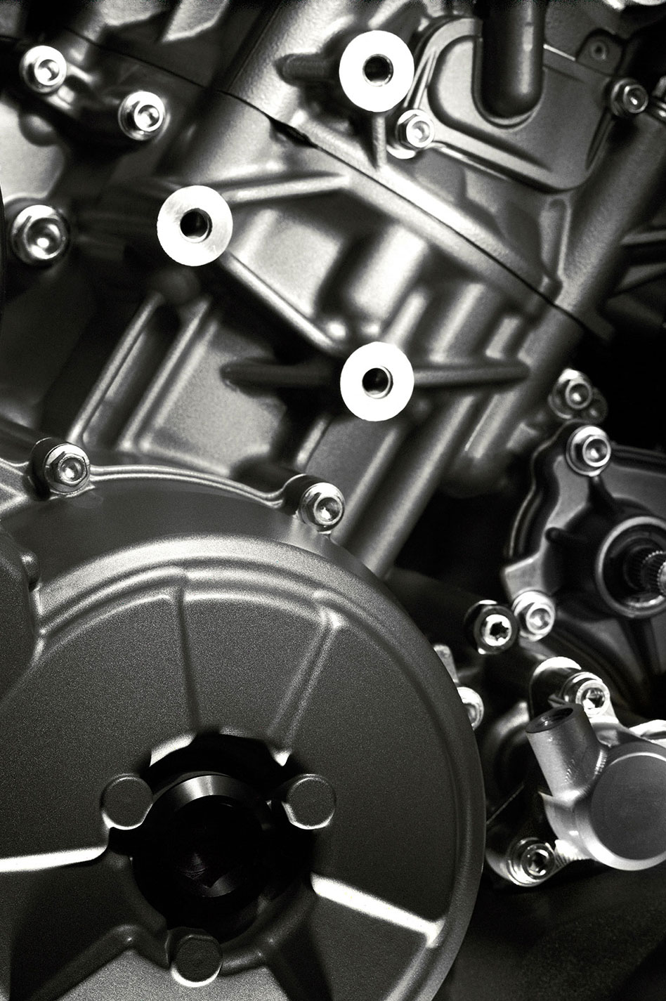

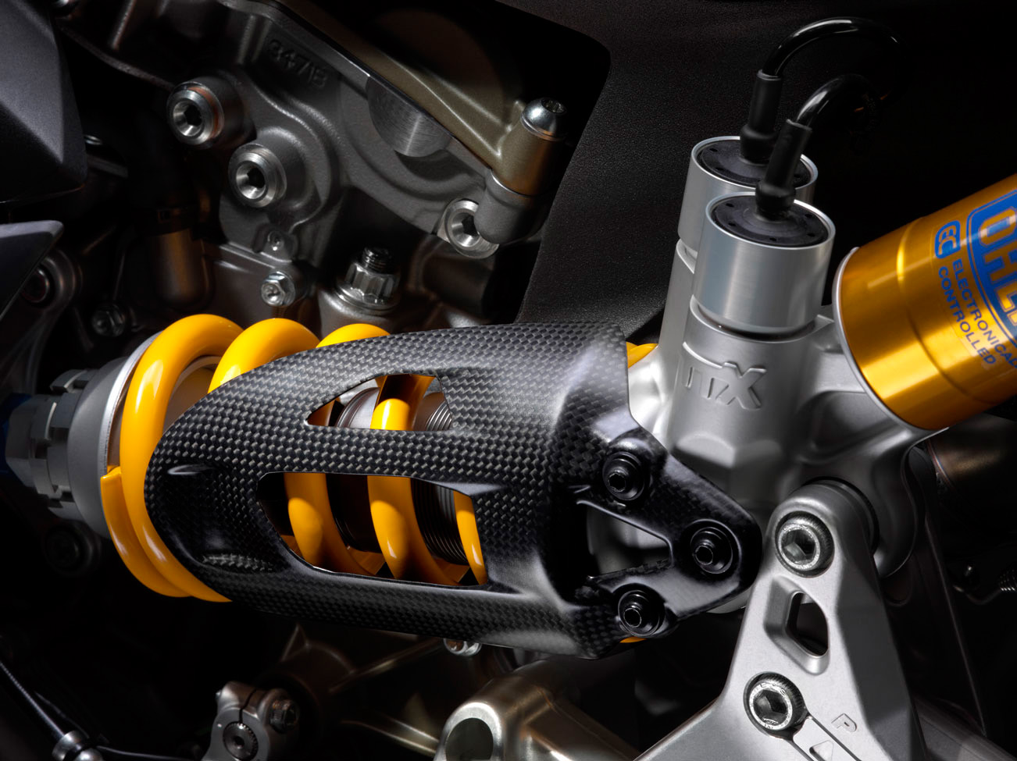

Slide 9
Engines
Engines can be considered miniature applications that provide functionality to their host applications.
Rails minus everything you need to get it booted.
Gemfile vs. Gemspec
Models
Views
Controllers
Concerns
Helpers
Assets
Routes
Rake Tasks
Middleware
Generators
Initializers
Migrations
Libraries
Seeds
Share functionality across multiple rails apps.
Good idea for delivering projects to clients that already have a rails app.
Big part of Component Based Architecture!
They are a rack app like other middleware systems

Slide 10
Examples
Forem: Adds a forum system to a rails app
Devise: Plug and play authentication
Spree: Fully functional e-commerce platform
Dashboard: Reads through all the controllers and extracts views that are candidates for being displayed on the dashboard
HelpEngine: Lets you manage and place context sensitive help links
RefineryCMS: Provides content management
MegaBar: An enterprise scale website and api building tool

Slide 11
MegaBar
Enterprise-scale website and api building tool
Control for multiple themes and sites. Examples:
Newspapers/Magazines
Real estate sites
Schools
Support for hundreds of models on hundreds of pages for hundreds of sites with multiple themes in a single instance.
Easy to build data entry systems! - Our first client!
GUI-based development with rails standard code overrides.
API development

Slide 12
Megabar Part 2
What’s the Vision?
After the core MVC Stuff is settled and spec’d:
Layout Engine: Supports multiple pages with multiple layouts and multiple containers per layout. Supports responsive, mobile, blueprint, bootstrap.
Theme Engine: Supports multiple sites and sharing multiple themes
Asset Engine: Allows JavaScript and other assets to be assigned to things at any level from a checkbox to pages to themes.
Lots of UX attention to make it easy to use.

Slide 13


Slide 14
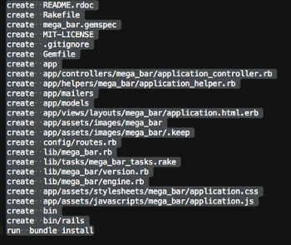
BASICS
Start An Engine:
rails plugin new MegaBar —mountable
Mountable like ‘full’ but does more.. adds asset manifest files, namespaces application controller, and more. Makes it more an rails app than a few methods.
re: —dummy-path=spec/test_app - I use Combustion gem for testing
Watch it go:

Slide 15
BASICS
Gemspec:
mega_bar/mega_bar.gemspec
$:.push File.expand_path("../lib", __FILE__)
# Maintain your gem's version:
require "mega_bar/version"
# Describe your gem and declare its dependencies:
Gem::Specification.new do |s|
s.name = "mega_bar"
s.version = MegaBar::VERSION
s.authors = ["Bagus et al"]
s.email = ["bagus@megabar.net"]
s.homepage = "http://www.github.com/mega_bar/mega_bar"
s.summary = "MegaBar Rails Engine"
s.description = "An enterprise scale website and api building tool "
s.license = "MIT"
s.files = Dir["{app,config,db,lib}/**/*", "spec/internal/factories/**/*", "MIT-LICENSE", "Rakefile", "README.rdoc"]
# s.add_development_dependency "rspec", "~> 2.6"
#s.add_development_dependency 'rspec-rails'
s.add_dependency "rails"
s.add_dependency 'seed_dump'
s.add_dependency 'seedbank'
s.add_development_dependency 'combustion', '~> 0.5.2'
s.add_development_dependency "rake", "~> 10.0"
s.add_development_dependency 'rspec-core'
s.add_development_dependency "simplecov", '~> 0.7.1'
s.add_development_dependency "sqlite3"
s.add_development_dependency 'factory_girl_rails'
s.test_files = Dir["spec/**/*"]
end
Publish your Gem to rubygems:
gem push mega_bar-0.0.1.gem

Slide 16
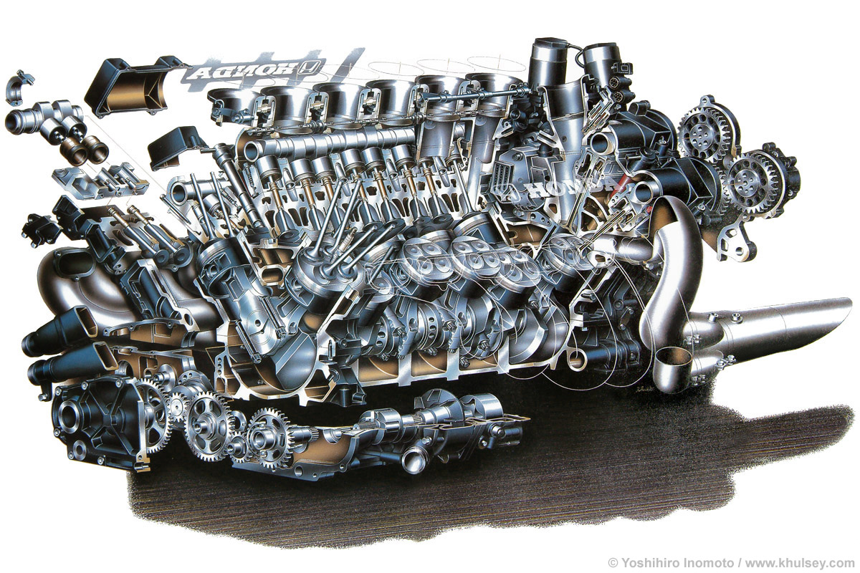

Slide 17
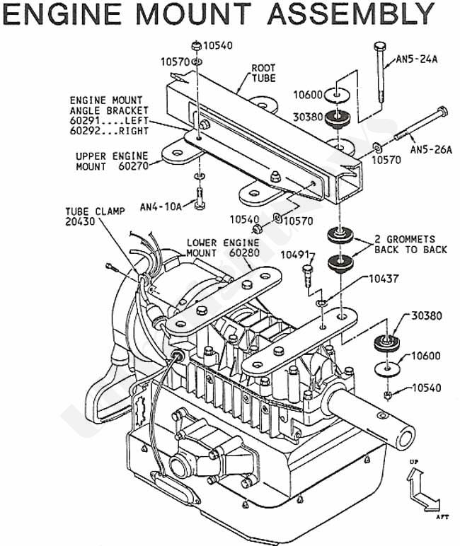

Slide 18
LEt’s Mount it!
Create a new rails app or use an existing: rails new host_app
Edit the host app’s Gemfile and add the engine like you would any other gem:
gem 'mega_bar', :path => '../megabar/'
‘Mount’ the mega_bar routes into host app’s config/routes.rb:
mount MegaBar::Engine, at ‘/mega-bar/’
Then start your server:
rails s
Other MegaBar installation instructions on Github page.

Slide 19
BASICS
Gemfile:
host_app/Gemfile
If you have 2 engines (admin_ui and public_ui) that both require a 3rd engine (domain_logic) and all 3 are in a ‘components’ directory, you’d either have to list them all in your Gemfile:
gem 'admin_ui', path: ‘../components/admin_ui’
gem 'public_ui', path: ‘../components/public_ui’
gem 'domain_logic', path: ‘../components/domain_logic’
Or you can wrap them with a ‘path’ and then Bundler will find the dependency.
path ‘../components’ do
gem 'admin_ui'
gem 'public_ui'
end

Slide 20
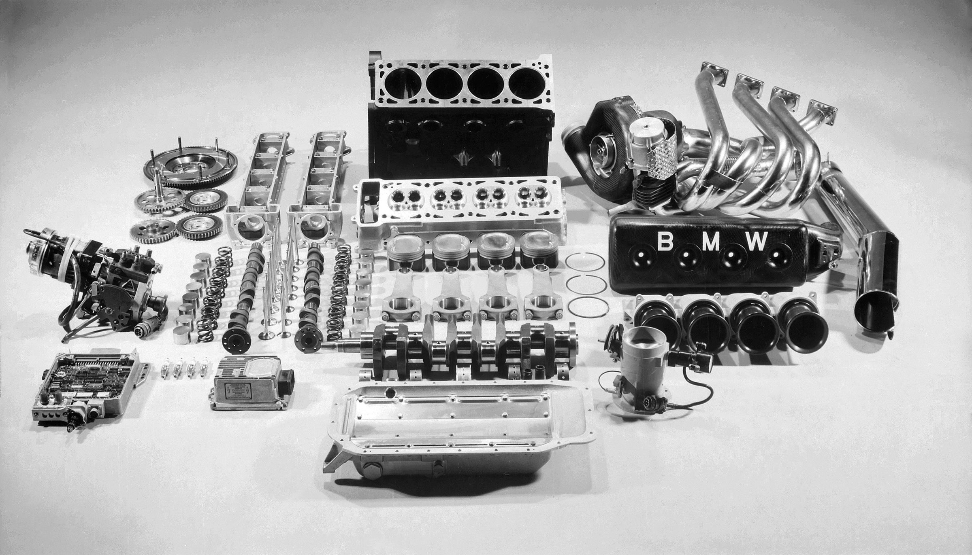

Slide 21
The App Directory
Controllers
Application Controller
Controller Concerns
Models
Model Concerns
Assets
Helpers
Views

Slide 22
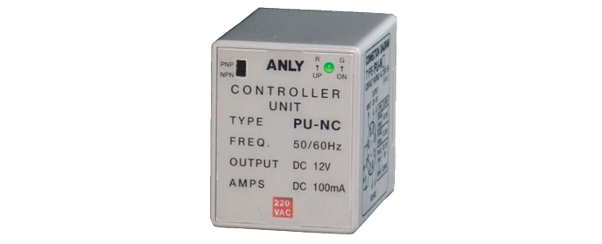

Slide 23
The App Directory
Controller Example:
mega_bar/app/controllers/mega_bar/fields_controller.rb
Namespaced
Namespaced
module MegaBar
class FieldsController < ApplicationController
include MegaBarConcern
end
end

Slide 24
The App Directory
Application Controller:
mega_bar/app/controllers/mega_bar/application_controller.rb
Namespaced
Namespaced
module MegaBar
class ApplicationController < ActionController::Base
# Prevent CSRF attacks by raising an exception.
# For APIs, you may want to use :null_session instead.
protect_from_forgery with: :exception
helper_method :sort_column, :sort_direction, :is_displayable
before_action :set_vars_for_all
before_action :set_vars_for_displays, only: [:show, :index, :new, :edit]
def _params
permits = []
MegaBar::Field.by_model(env[:mega_env][:model_id]).pluck(:field).each do |att|
permits << att unless ['id', 'created_at', 'updated_at'].include?(att)
end
params.require(controller_name.singularize).permit(permits)
end
end
end

Slide 25


Slide 26
The App Directory
Controller Concern:
mega_bar/app/controllers/mega_bar/mega_bar_concern.rb
note: not in concerns subdirectory
Namespaced
Namespaced
module MegaBar
module MegaBarConcern
extend ActiveSupport::Concern
def index
records = @mega_class.where(@conditions).order(sort_column(params) + " " + sort_direction(params))
instance_variable_set("@" + env[:mega_env][:kontroller_inst].pluralize, records)
@mega_instance = instance_variable_get("@" + env[:mega_env][:kontroller_inst].pluralize);
render @index_view_template
end
def show
…
end
def etc…
end
def sort_column(mega_class, model_properties, passed_params)
end
end
end
Concerns are Modules
With Engines, it’s easier to apply concerns to certain modules without affecting the entire application.
MegaBar has really dry’d things up!

Slide 27
The App Directory
Model Example:
mega_bar/app/models/mega_bar/model_display.rb
Namespaced
Namespaced
module MegaBar
class ModelDisplay < ActiveRecord::Base
include MegaBar::MegaBarModelConcern
belongs_to :blocks
has_many :field_displays, dependent: :destroy
validates_presence_of :block_id, :action, :format
scope :by_block, ->(block_id) { where(block_id: block_id) if block_id.present? }
end
end

Slide 28
The App Directory
Model Concern:
mega_bar/app/models/mega_bar/mega_bar_model_concern.rb
Namespaced
Namespaced
module MegaBar
module MegaBarModelConcern
module ClassMethods
def since(date)
table = self.to_s.downcase.pluralize
date = DateTime.parse(date).strftime('%Y-%m-%d %H:%M:%S')
where "#{table}.updated_at >= ? or
#{table}.created_at >= ?", date, date
end
end
end
end
Scopes, etc.

Slide 29
The App Directory
Assets in Engine:
mega_bar/app/assets/javascripts/mega_bar/application.js
The App Directory
Assets in Host App:
host_app/app/assets/javascripts/application.js
//= require mega_bar/application.js
Namespaced
//= require_tree .

Slide 30
The App Directory
Application Helper:
mega_bar/app/helpers/mega_bar/application_helper.rb
Namespaced
Namespaced
module MegaBar
module ApplicationHelper
def sortable(column, title=nil)
title ||= column.titleize
css_class = column == sort_column(@mega_class,
@mega_model_properties, params) ? 'current ' +
sort_direction(params) : nil
direction = column == sort_column(@mega_class,
@mega_model_properties, params) &&
sort_direction(params) == 'asc' ? 'desc' : 'asc'
link_to title, {:sort => column, :direction => direction,
controller: @kontroller_path}, class: css_class
end
end
end

Slide 31
The App Directory
Views:
mega_bar/app/views/mega_bar/master_pages/render_page.html.erb
Namespaced
<!DOCTYPE html>
<html>
<head>
<title><%=page_title%></title>
<%= stylesheet_link_tag "application", media: "all", "data-turbolinks-track" => true %>
<%= javascript_include_tag "application", "data-turbolinks-track" => true %>
<%= csrf_meta_tags %>
</head>
<body>
<%= link_to 'Models', mega_bar.models_path %> |
<%= link_to 'Fields', mega_bar.fields_path %> |
<%= link_to 'Field Displays', mega_bar.field_displays_path %> |
<% flash.each do |key, msg| %>
<div id="<%= key %>">
<p><%= msg %></p>
<div class="clear"></div>
</div>
<% end %>
<% @page_layouts.each do |layout| %>
<div class='layout'><%=layout%></div>
<% end %>
</body>
</html>
MegaBar here has collected output from multiple controllers into ‘layouts’ and puts multiple layouts onto the final page.
MegaBar controllers all share a (different) single view for forms and things

Slide 32

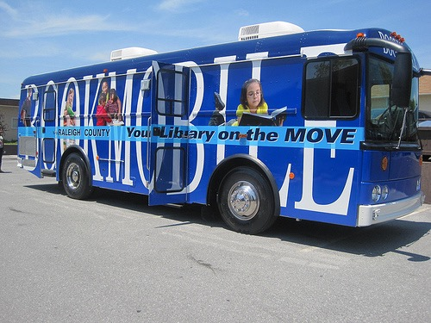
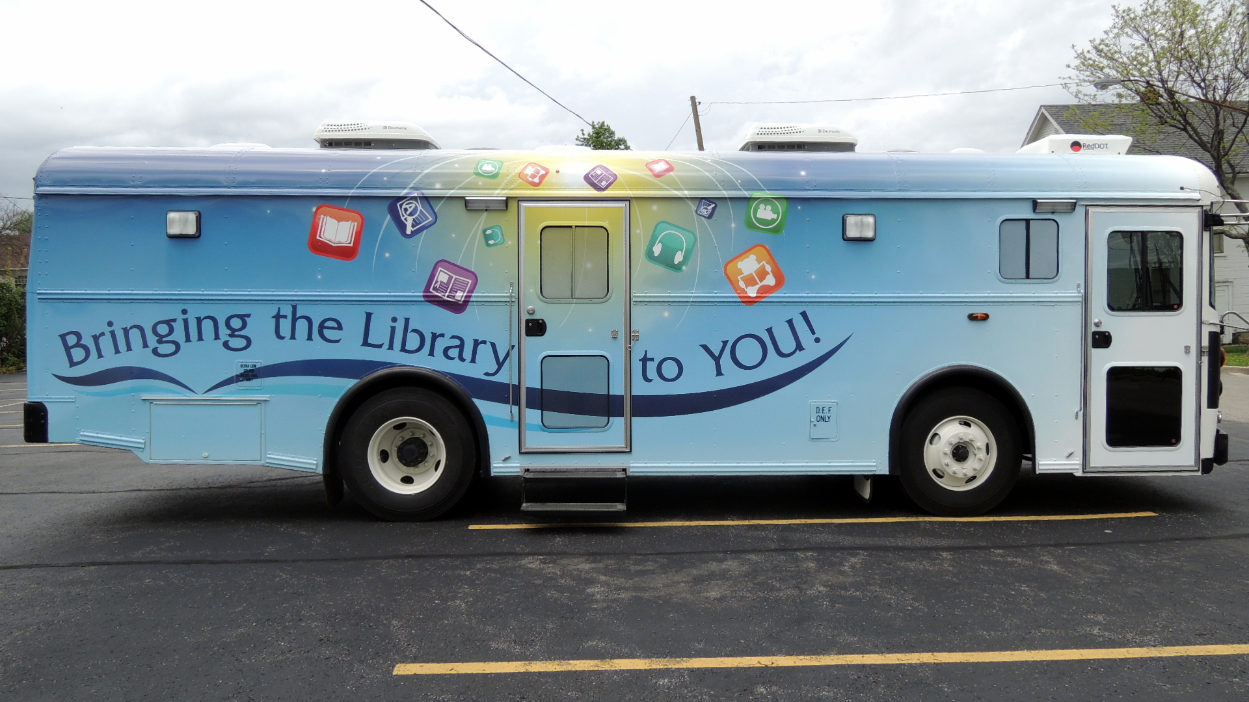

Slide 33
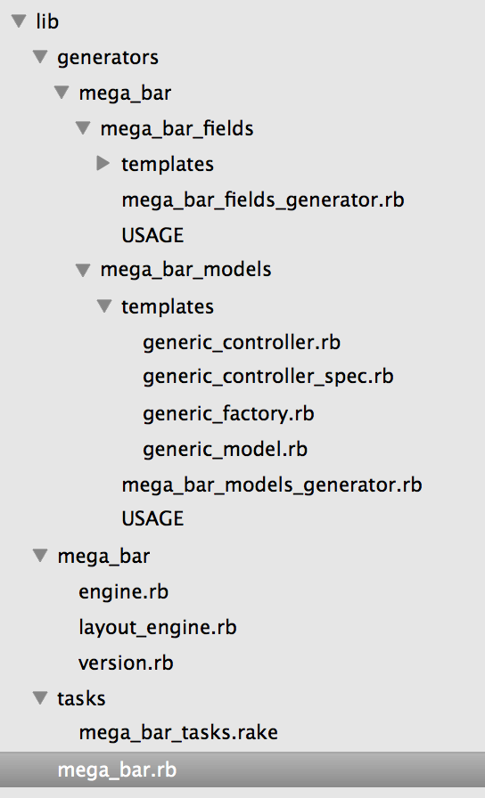
The Lib Directory
Generators
Namespaced Directory
Engine File
Middleware File
Version File
Rake Tasks File
Module File

Slide 34
The LIB Directory
The Module:
mega_bar/lib/mega_bar.rb
require "mega_bar/engine"
module MegaBar
end
You could chuck everything in here, but since other files that start with “module MegaBar” and are in namespace directories include the Engine, we can structure them like a regular rails app, but in our engine’s app directory.

Slide 35
The LIB Directory
The Engine File:
mega_bar/lib/mega_bar/engine.rb
Identical in function to a standard app’s config/application.rb.
isolate_namespace MegaBar:
Makes generators create controllers and models with the mega_bar namespace and in mega_bar subdirectories.
Makes generated tables prefixed with mega_bar_
Load your middleware
Dependencies added in your gemspec file must be required in your engine file!
append_migrations initializer automatically makes your host apps see your migrations.
Share your factories!
Rspec!

Slide 36
The LIB Directory
The Engine:
mega_bar/lib/mega_bar/engine.rb
Namespace in module
Inherit from Rails::Engine
Place in lib/mega_bar/engine.rb
module MegaBar
class Engine < ::Rails::Engine
isolate_namespace MegaBar
require ‘seed_dump'
require 'best_in_place'
config.autoload_paths << File.expand_path("../*", __FILE__)
# MIDDLEWARE
require File.expand_path('../layout_engine.rb', __FILE__)
config.app_middleware.use LayoutEngine
initializer :append_migrations do |app|
unless app.root.to_s.match root.to_s
config.paths["db/migrate"].expanded.each do |expanded_path|
app.config.paths["db/migrate"] << expanded_path
end
end
end
initializer "model_core.factories", :after => "factory_girl.set_factory_paths" do
FactoryGirl.definition_file_paths << File.expand_path('../../../spec/factories', __FILE__) if defined?(FactoryGirl)
end
config.generators do |g|
g.test_framework :rspec
g.fixture_replacement :factory_girl, :dir => 'spec/factories'
g.assets false
g.helper false
end
config.action_view.logger = nil
end
end
Avoid Naming Conflicts; Generators create mvc’s in namespaced directories. Migrations and table names namespaced too.
Require your Gems
Include your Middleware
Make host app aware of your migrations. Otherwise you can run them manually.
Make host app aware of your factories.
The engine file is identical in Function to a regular rails app’s application.rb
Generate RSpecs.

Slide 37
The LIB Directory
Tasks:
mega_bar/lib/tasks/mega_bar_tasks.rake
MegaBar uses seed data to store configurations for stuff.
Seeds are loaded into apps:
Seeds can be dumped from apps.
Seeds get merged back into master.
myapp$ bundle exec rake mega_bar:data_load
myapp$ bundle exec rake mega_bar:dump_seeds

Slide 38
The LIB Directory
Tasks:
mega_bar/lib/tasks/mega_bar_tasks.rake
host_app> bundle exec rake mega_bar:engine_init
namespace :mega_bar do
desc 'engine_init' # adds mount to host apps routes file
task engine_init: :environment do
# add mounting to routes file in host app
text = File.read('config/routes.rb')
new_contents = text.gsub( /(#{Regexp.escape(line)})/mi, "#{line} mount MegaBar::Engine, at: '/mega-bar'\n")
File.open('config/routes.rb', "w") {|file| file.puts new_contents }
puts "Mounted the engine in the routes file”
Rake::Task[“db:migrate"].invoke
puts "Migrated the mega_bar db”
Rake::Task[‘mega_bar:data_load'].invoke
puts "Loaded the seed data"
File.open('app/assets/javascripts/application.js', 'a') { |f|
f.puts "//= require mega_bar/application.js "
}
File.open('app/assets/stylesheets/application.css', 'a') { |f|
f.puts "//= require mega_bar/application.css "
}
puts 'Added mega_bar assets to the pipeline'
puts "Yer all set!"
end
end

Slide 39
The LIB Directory
Middleware:
mega_bar/lib/mega_bar/layout_engine.rb
Middleware is a filter which intercepts request and handle response differently as it goes to and from the application.
Must have a call method that returns something like:
@status, @headers, @body = SomeController.action(:index).call(env)
Behind the scenes, when a route is processed, this is how the controller actually gets called.
See the railscast!

Slide 40
The LIB Directory
Middleware:
mega_bar/lib/mega_bar/layout_engine.rb
See: http://railscasts.com/episodes/151-rack-middleware
Try: host_app>rake middleware
use Rack::Sendfile
use ActionDispatch::Static
use Rack::Lock
use #<ActiveSupport::Cache::Strategy::LocalCache::Middleware:0x007ff072e839c8>
use Rack::Runtime
use Rack::MethodOverride
use ActionDispatch::RequestId
use Rails::Rack::Logger
use ActionDispatch::ShowExceptions
use ActionDispatch::DebugExceptions
use ActionDispatch::RemoteIp
use ActionDispatch::Reloader
use ActionDispatch::Callbacks
use ActiveRecord::Migration::CheckPending
use ActiveRecord::ConnectionAdapters::ConnectionManagement
use ActiveRecord::QueryCache
use ActionDispatch::Cookies
use ActionDispatch::Session::CookieStore
use ActionDispatch::Flash
use ActionDispatch::ParamsParser
use Rack::Head
use Rack::ConditionalGet
use Rack::ETag
use LayoutEngine
run HostApp::Application.routes

Slide 41
The LIB Directory
Middleware:
Fun with Rack
# Fun with Rack::Request!
request = Rack::Request.new(env)
request.path_info
# "/mega-bar/models/"
request.url
# "http://localhost:3000/mega-bar/models?direction=asc&sort=name"
request.request_method
# "GET"
request.host_with_port
# "localhost:3000"
#list out routes:
MegaBar::Engine.routes.routes.named_routes.values.map do |route|
puts "#{route.defaults[:controller]}##{route.defaults[:action]}"
end
# Find which route matches path_info:
my_route = (Rails.application.routes.recognize_path request.path_info rescue {}) || {}

Slide 42
The LIB Directory
Middleware:
Messing with the params hash
# Fun with PARAMS HASH #http://localhost:3000/mega-bar/models/1?sort=name&direction=asc
# 1)
orig_query_hash = Rack::Utils.parse_nested_query(env[‘QUERY_STRING'])
### {"direction"=>"asc", "sort"=>"action"}
# 2)
new_query_hash = orig_query_hash.merge({something: 'new', whatever: ‘else'})
### {"direction"=>"asc", "sort"=>"action", :something=>"new", :whatever=>"else"}
# 3)
env['QUERY_STRING'] = orig_query_hash.to_param
### direction=asc&something=new&sort=name&whatever=else
# 4) This really sets it.
env[‘rack.request.form_hash’] = new_query_hash
# 5) Then in your controller:
params.inspect
### {"action"=>"index", "controller"=>"mega_bar/models", "direction"=>"asc", "something"=>"new", "sort"=>"name", “whatever"=>"else"}
# Make your own”
env[:mega_env] = { model_id: modle.id, mega_model_properties: modle}

Slide 43
The LIB Directory
Middleware:
mega_bar/lib/mega_bar/layout_engine.rb
MegaBar Layout Engine Flow
determine which page record is for our current page.
get layout records for that page
For each layout, get blocks
For each block, get model_displays
For each model_display, get field_displays
For each field_display, get data_display (ie ‘textbox’)
Call controller, and render html for block
Package model_displays in the block
Package Blocks in the layout.
Get Rendered layout
Package layouts in page
Call to render page.

Slide 44
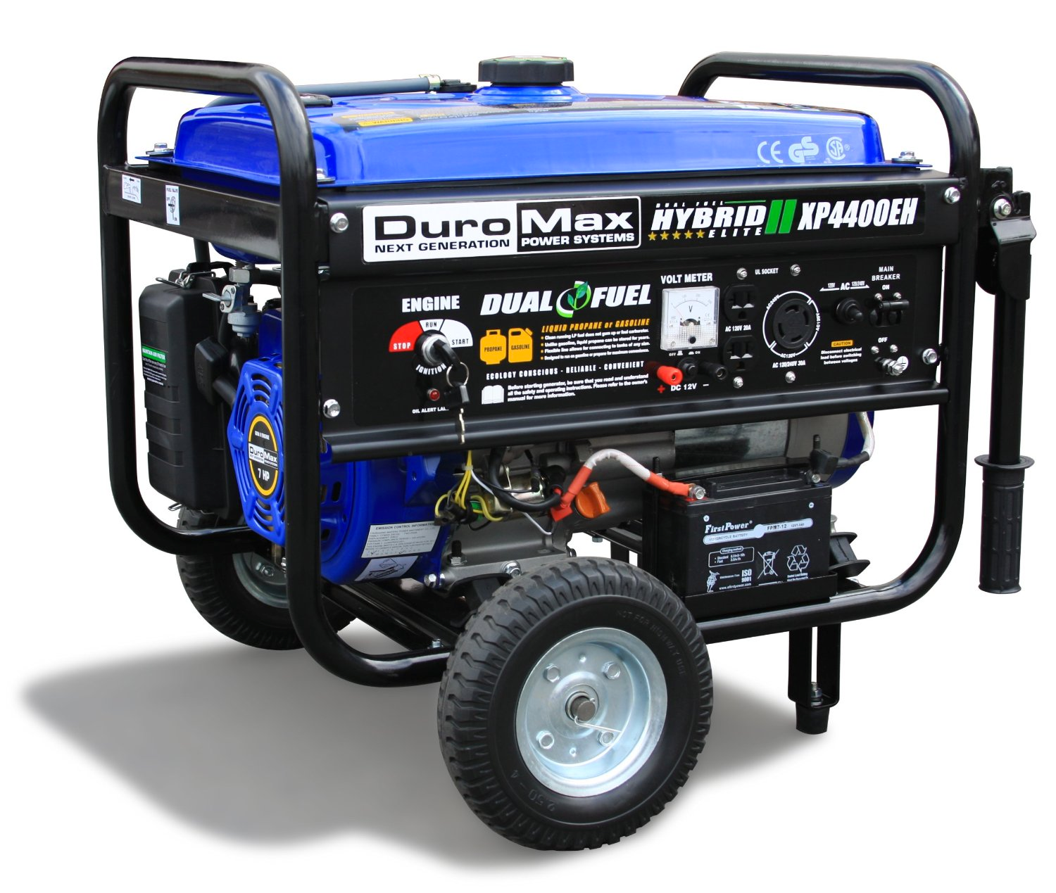

Slide 45
The LIB Directory
Generators:
mega_bar/lib/generators/mega_bar/mega_bar_models/mega_bar_models_generator.rb
mega_bar/lib/generators/mega_bar/mega_bar_models/templates/generic_controller.rb
Namespaced
Namespaced
rails g mega_bar:mega_bar_models Friend 22
(Passes two arguments: 1. Classname 2. ID of new model record.)

Slide 46
The LIB Directory
Generators:
mega_bar/lib/generators/mega_bar/mega_bar_models/mega_bar_models_generator.rb
namespaced
namespaced
folder and file named after class
Inherit from Rails::Generators::Base
folder and file named after class
module MegaBar
class MegaBarModelsGenerator < Rails::Generators::Base
source_root File.expand_path('../templates', __FILE__)
argument :filename, type: :string
argument :model_id, type: :integer
def create_controller_file
template 'generic_controller.rb', "#{the_controller_file_name}.rb"
end
def create_model_file
template 'generic_model.rb', "#{the_model_file_name}"
end
def generate_migration
if the_module_name
generate 'migration create_' + the_module_name + '_' + the_table_name + ' created_at:datetime updated_at:datetime'
else
generate 'migration create_' + the_table_name + ' created_at:datetime updated_at:datetime'
end
end
def add_route
line = ' ##### MEGABAR END'
text = File.read('config/routes.rb')
new_contents = text.gsub( /(#{Regexp.escape(line)})/mi, ' resources :' + the_route_name + ', defaults: {model_id: ' + model_id + "}\n #{line}\n")
# To write changes to the file, use:
File.open('config/routes.rb', "w") {|file| file.puts new_contents }
end
private
def the_model_file_name
if the_module_name
'app/models/' + the_module_name.underscore + '/' + the_file_name.to_s.singularize.underscore + '.rb'
else
'app/models/' + the_file_name.to_s.singularize.underscore + '.rb'
end
end
…
Take Arguments
In generators, all public methods are run.
Weird, huh?
Specify your generator template
Specify file name to write.
Use private methods to set variables needed by the public methods above and in the generator templates.

Slide 47
The LIB Directory
Generator Templates:
example: /mega_bar/lib/generators/mega_bar/mega_bar_models/templates/generic_controller.rb
This Template
class <%= the_controller_name %> < MegaBar::ApplicationController
include MegaBar::MegaBarConcern
end
Makes this Controller:
Note this is not namespaced and is part of the host app.
class FriendsController < MegaBar::ApplicationController
include MegaBar::MegaBarConcern
end
/host_app/app/controllers/friends_controller.rb

Slide 48
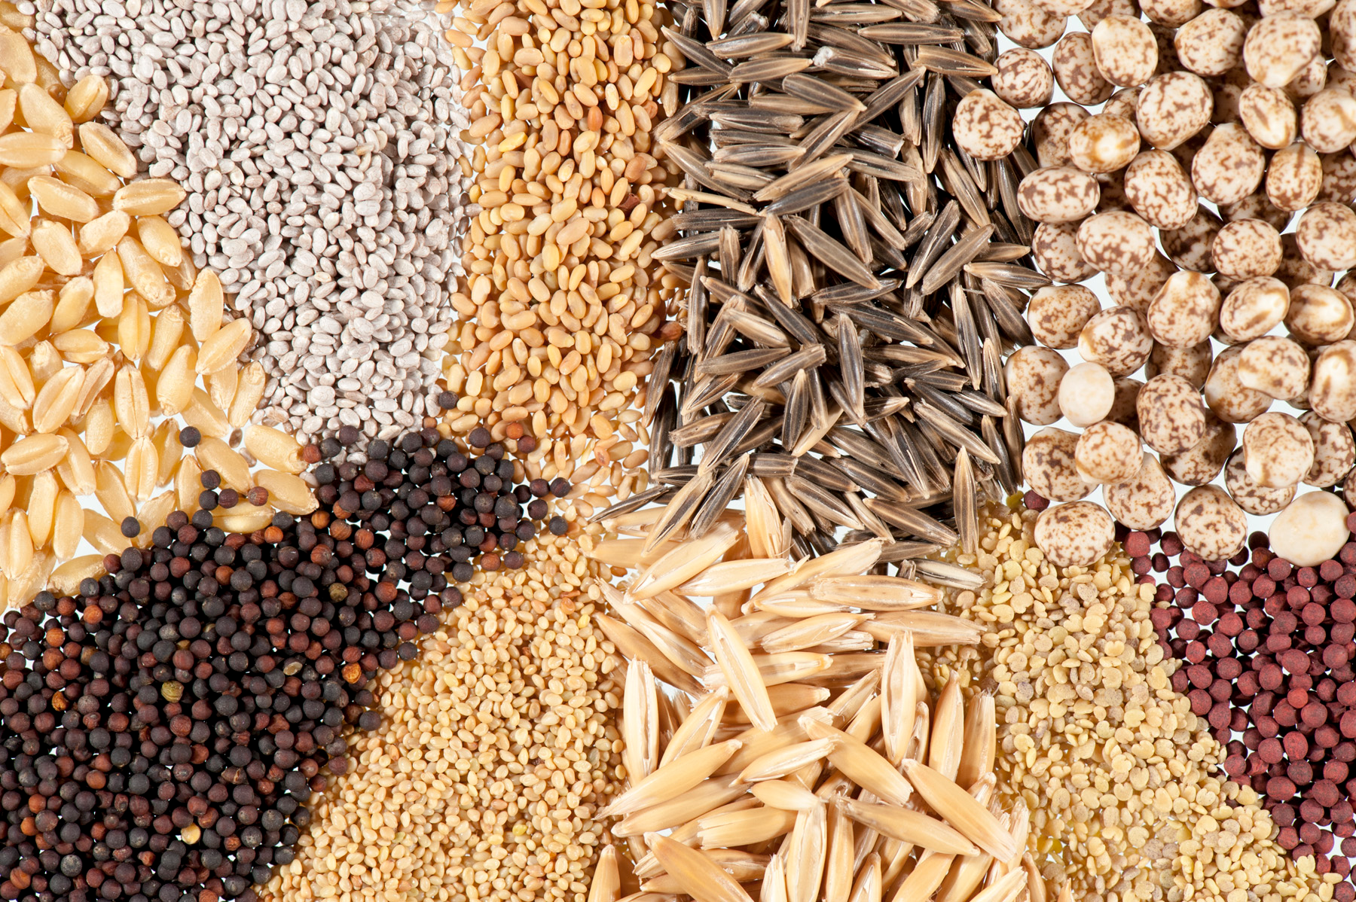

Slide 49
Seeds!
/db/mega_bar.seeds.rb
MegaBar uses seed data to store configurations for stuff.
Seeds are copied from the mega_bar repo to your app:
Seeds are loaded into apps:
Seeds can be dumped from apps.
Seeds get merged back into master.
cp megabar/db/mega_bar.seeds.rb myapp/db/.
bundle exec rake mega_bar:data_load
bundle exec rake mega_bar:dump_seeds

Slide 50
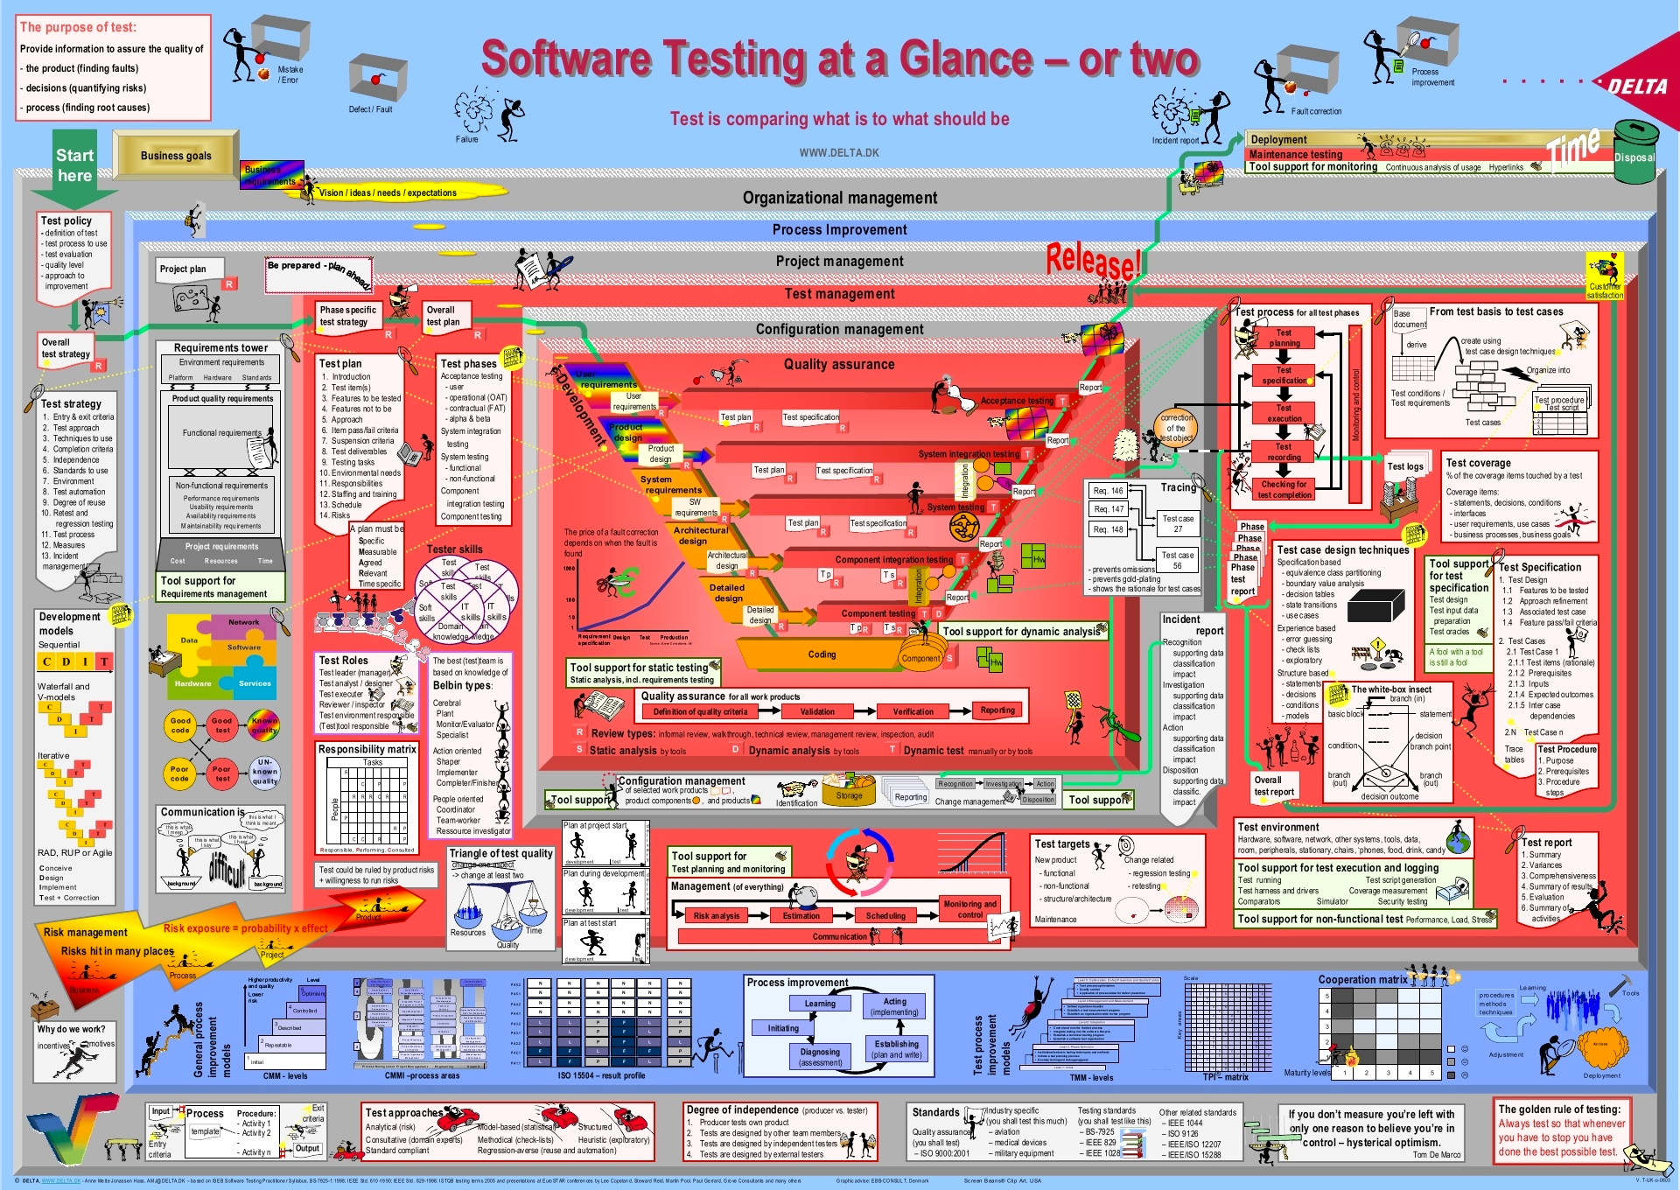

Slide 51
SPECS with Combustion
Rails engines are tested within their repo. You need a fake app in the spec directory.
Combustion Minimizes That!
There’s some config:
in gemspec: s.add_development_dependency 'combustion', '~> 0.5.2’.
run: mega_bar> bundle exec combust
in your spec_helper before require ‘rspec/rails’: Combustion.initialize! :all
bundle exec combust creates an ‘/spec/internal’ directory, and db/ (and a test db) and config/ directories .
You can add /spec/internal/app/models if you need them. MegaBar so far doesn’t.
/spec/internal/config/routes.rb has to mount the engine.

Slide 52
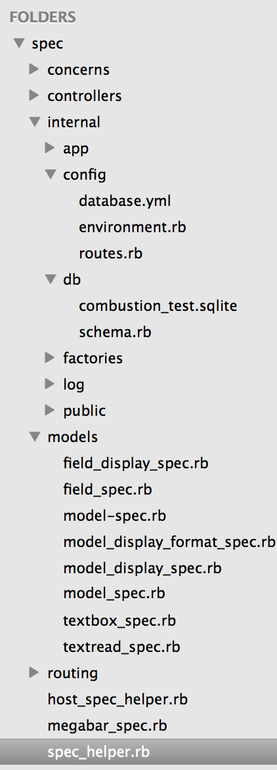
Spec Directory
mega_bar_concern specs!
lots of our controller specs!
empty, so far
mount your engine routes!
test db and schema
factories for all the models!
model specs
a sample spec_helper file for testing within host app!
routing specs
tests that MegaBar is a module
require rspec-rails, combustion, etc

Slide 53
Specs
/specs/controllers/models_controller_spec.rb
it "assigns a new model as @model" do
get :new, {use_route: :mega_bar}, valid_session
expect(assigns(:model)).to be_a_new(Model)
end
let rspec know about your namespacing of routes.
Testing Controllers with Rack
I had to switch things around to call controllers the way my middleware does
describe "GET index" do
it "assigns all models as @mega_instance" do
env = Rack::MockRequest.env_for('/mega-bar/models', :params => collection_params )
env[:mega_bar_stuff] = …
status, headers, body = MegaBar::ModelsController.action(:index).call(env)
@controller = body.request.env['action_controller.instance']
expect(assigns(:mega_instance)).to eq([model])
end
end

Slide 54
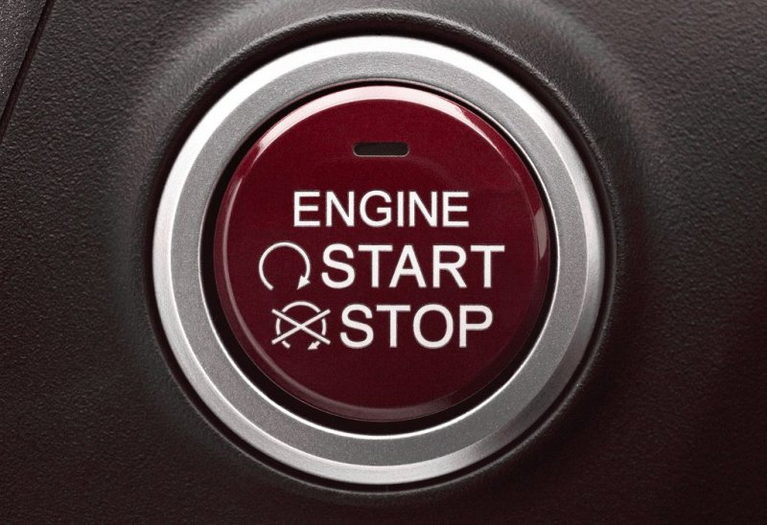

Slide 55
Enterprise-scale website and api building tool

Slide 56
MegaBar Needs You!
Where We Are
Building support for 'data display' items:
Checkboxes
Radio Buttons
Text Areas
WYSIWYGs
File uploads
etc
It doesn’t exist
You can make it work
It’s easy to make it work
It does a lot
You can’t break it

Slide 57
MegaBar Needs You!
Where We’re Going
Seeking help with:
DOM and Style Management
Multi Site Management
Asset management
Users and User roles
Theming systems
Want to contribute to a Rails project?
You can have a big impact here!

Slide 58
EnGines R Us!
Rails Engines Lets Applications Reuse:

Slide 59
More Engines
Typically rails app files load before Engine files.
You may want to reverse this so that an app can override engine code:
config.railties_order = [MegaBar::Engine, :main_app, :all]

Slide 60
Resources
Components at Mountain West: https://www.youtube.com/watch?v=-54SDanDC00
Engines: http://guides.rubyonrails.org/engines.html
Start Here: http://guides.rubyonrails.org/engines.html
Or Here: http://railscasts.com/episodes/277-mountable-engines
Examples: http://www.toptal.com/ruby-on-rails/rails-engines-in-the-wild-real-world-examples-of-rails-engines-in-action
Rails 4 Engines info: http://tech.taskrabbit.com/blog/2014/02/11/rails-4-engines/
Multiple Engines at once: http://pivotallabs.com/migrating-from-a-single-rails-app-to-a-suite-of-rails-engines/
A nice presentation: http://www.slideshare.net/AndyMaleh/rails-engine-patterns
Combustion: https://github.com/pat/combustion
Publishing a Gem: http://guides.rubygems.org/publishing/
Testing Controllers with Rack: http://dev.af83.com/2011/02/22/rails-3-controllers-unit-testing-with-rack.html
Service Objects: https://blog.engineyard.com/2014/keeping-your-rails-controllers-dry-with-services

Slide 61
Action
Check Out MegaBar repo:
https://github.com/megabar/megabar
Check Out MegaBar site:
http://megabar.net
Contact Me: bagus@megabar.net
Give me your email address if you are interested in joining our Slack.. megabar.slack.com

Slide 62
